Slide 1
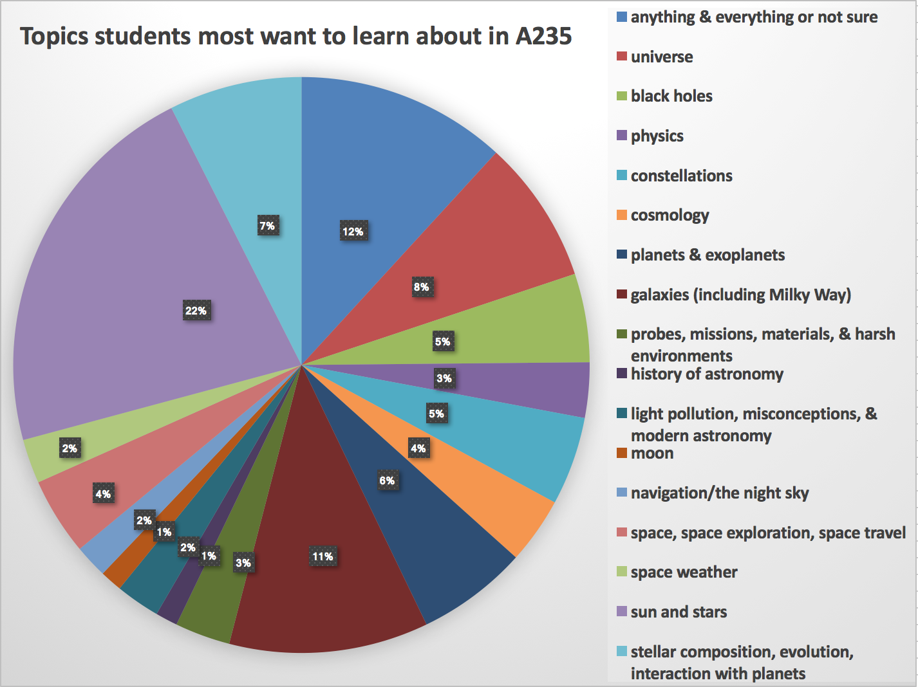

Slide 2
(Logistical note/demo: MasteringAstronomy)
Assignment 1: Tutorial on how to use Mastering Astronomy, due by 8/23, 11:59pm. Average time: 23 minutes
Assignment 2: Chapter 1, due by 8/22, 11:59pm. Estimated time: 51mins
Try to do homeworks as early as you possibly can, they have tutorials, animations, and helpful info- not just questions.
Notes:
I’ll open up homeworks at noon the day they’re assigned. You’ll have 1 week to complete, after due date you can still do them for half credit.

Slide 3
Today in science…
“Academic writes 270 Wikipedia pages in a year to get female scientists noticed”
https://www.theguardian.com/education/2018/jul/24/academic-writes-270-wikipedia-pages-year-female-scientists-noticed
In 2011, 90% of Wikipedia contributors/editors surveyed identified as male and white
Who the contributors are affect what the content is you read!
Dr. Jess Wade
https://en.wikipedia.org/wiki/Emma_McCoy
https://en.wikipedia.org/wiki/Susan_Goldberg
https://en.wikipedia.org/wiki/Kim_Cobb
Notes:
https://www.theguardian.com/education/2018/jul/24/academic-writes-270-wikipedia-pages-year-female-scientists-noticed
Article about the effects of authorship on wikipedia and potential for biased content: http://journals.sagepub.com/doi/10.1177/2053951715614332

Slide 4
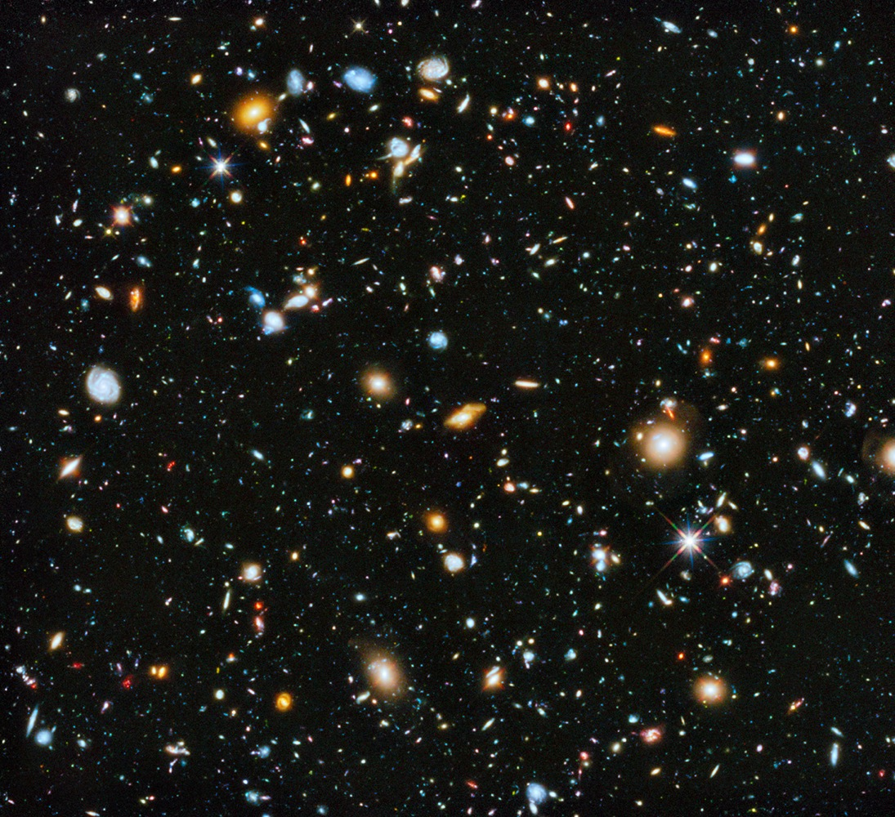
A Modern View of the Universe
The Cosmic Perspective, Chapter 1.
Assistant Professor Alicia Aarnio

Slide 5
Astronomical Definitions
Star
Large
Hot
Made of gases
Generates heat and light through nuclear fusion in their cores
Notes:
Let’s start with the Solar System..
Page 4 in your text
https://wattsupwiththat.com/2014/10/22/solar-flare-danger-massive-sunspot-the-size-of-jupiter-takes-aim-at-earth/
Star: large, hot ball of gas that generates heat and light through nuclear fusion

Slide 6
Astronomical Definitions
Star
Planet
Orbiting a star
Could be rocky, icy, gaseous (or a mix!)
Large enough to be round
Notes:
https://arstechnica.com/science/2014/09/images-come-down-as-maven-and-mom-get-to-work-at-mars/
https://www.nasa.gov/feature/goddard/2016/hubble-captures-vivid-auroras-in-jupiter-s-atmosphere
Planet: a body orbiting a star that could be rocky, icy, or gaseous; moderately large, enough so that when it formed, it became round

Slide 7
Astronomical Definitions
Star
Planet
Moon/satellite
Orbits a planet
Notes:
https://en.wikipedia.org/wiki/Ganymede_(moon)
https://en.wikipedia.org/wiki/Io_(moon)
https://www.space.com/11604-saturn-moon-titan-impacts-atmosphere.html
http://planetary-mechanics.com/tag/cassini/
Moon/satellite: orbits a planet

Slide 8
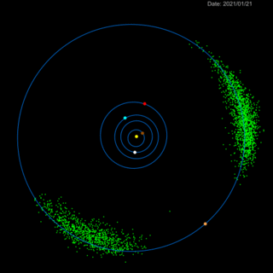
Astronomical Definitions
Star
Planet
Moon/satellite
Asteroid
Notes:
https://en.wikipedia.org/wiki/433_Eros
https://www.nasa.gov/content/goddard/lucy-the-first-mission-to-jupiter-s-trojans
Asteroid: a rocky body that orbits a star

Slide 9
Astronomical Definitions
Star
Planet
Moon/satellite
Asteroid
Comet
Small
Rock & ices
Elliptical or hyperbolic orbits
Ices evaporate close to Sun, making tail
Notes:
https://www.space.com/19878-halleys-comet.html
Comet: small body, rocky, but with frozen interiors. They’re typically on elliptical orbits that take them close enough to the sun to heat up and sublimate (go straight from ice to gas); the gases released are the ‘tails’ we observe

Slide 10
Astronomical Definitions
Galaxy
Collection of:
Stars, stellar systems, gas, orbiiting a massive center
Held together by gravity
Notes:
https://www.nasa.gov/content/hubble/grand-swirls-from-nasas-hubble
Galaxy: a collection of stars, star systems, and gas held together by gravity, orbiting around a massive center

Slide 11
Astronomical Definitions
Galaxy
Cluster of galaxies
A few: group
100s to 1000s: cluster
More? Supercluster!
Notes:
https://www.universetoday.com/30522/galaxy-cluster/
Cluster of galaxies: anywhere from a few (a group) to hundreds to thousands of galaxies bound together by gravity

Slide 12
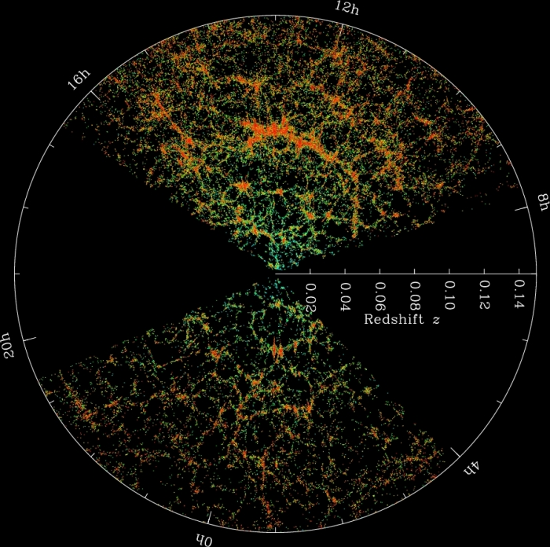
Astronomical Definitions
Galaxy
Cluster of galaxies
Universe, observable universe
Everything, everything we can observe
Notes:
https://wwwmpa.mpa-garching.mpg.de/galform/virgo/millennium/
Universe: all matter and energy, the sum total of it all
https://www.e-education.psu.edu/astro801/content/l10_p6.html
Observable universe: what we can observe from Earth, likely a very small fraction of the actual universe

Slide 13
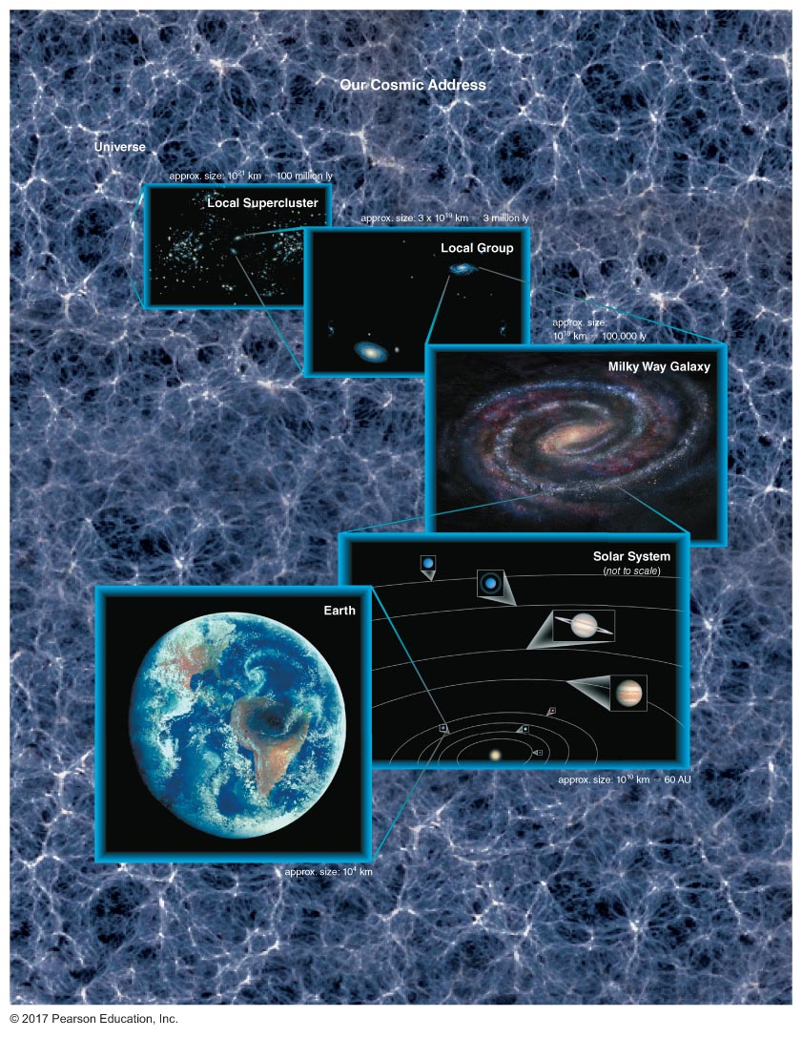
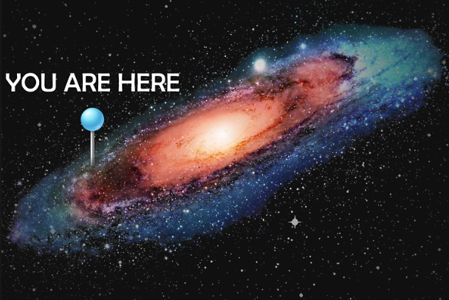
What is our place in the Universe?

Slide 14
Notes:
What do we see when we look up?
https://www.universetoday.com/74190/what-is-the-name-of-our-galaxy/

Slide 15
Notes:
What do we see when we look up?
https://www.universetoday.com/74190/what-is-the-name-of-our-galaxy/

Slide 16
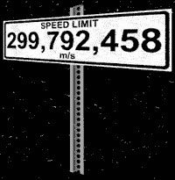
What is a light year?
Light year (LY)
The distance the light travels during 1 year
Speed of light abbreviated as c
c = 2.99x10⁸ m/s = 670 million mph!
1 LY =
speed × time =
c × t =
(3x10⁵ km/s) × (365.24 days) × (24 hours) × (60 minutes) × (60 s) = 9.46 trillion km
Convert to AU:
9.46x10¹² km ≈ 63,000 au
Notes:
1 AU is 1.496e+8 km
See mathematical insight 1.3 for more information on dimensional analysis and order-of-magnitude techniques

Slide 17
What is a light year?
Important figure of merit: The Sun is 8.3 light-minutes away from the Earth
…what does this mean for us?
This is a limit on space weather forecasting warning time!
Notes:
It means we only have, at most, 8 minutes’ warning if the Sun is doing something we need to be worried about! The speed of light is the fundamental limit, the fastest that information can travel.
GOES stands for Geostationary Operational and Environmental Satellite, it’s keeping an eye on the Sun and on the Earth for us
Image is of GOES 13: https://www.nasa.gov/directorates/heo/scan/services/missions/earth/GOES13.html
--> we’re currently on GOES-R, the 16th satellite in the GOES mission series

Slide 18
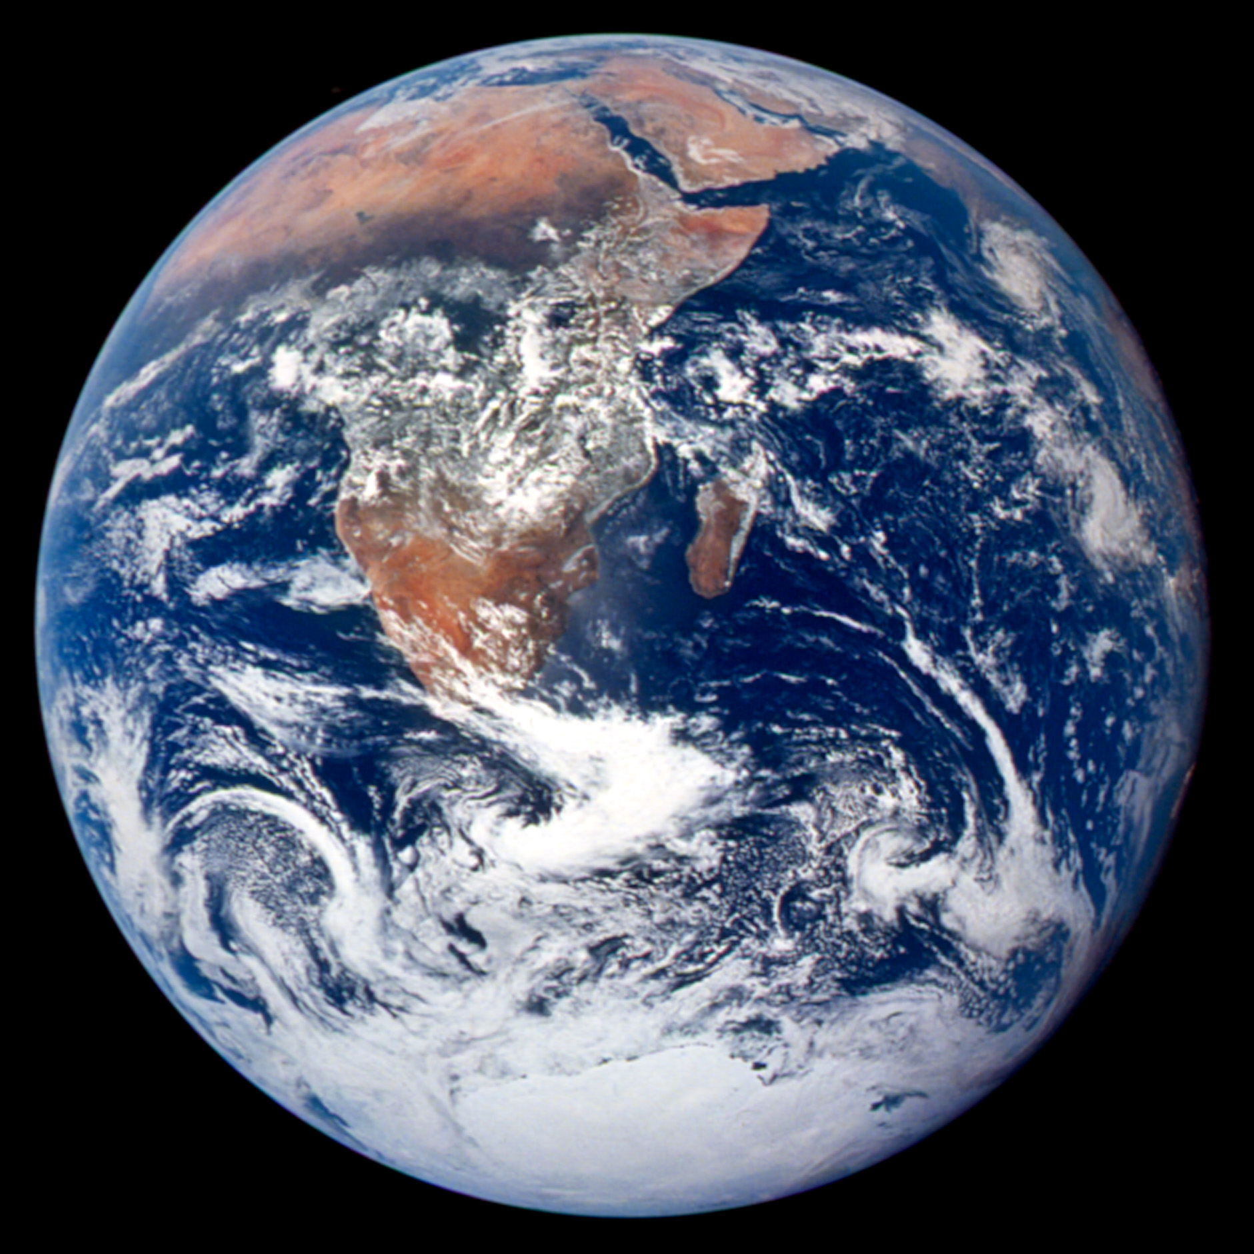
THE EARTH: 1/10th of a light-second all the way around
Notes:
The circumference of Earth is 24,901 mi

Slide 19
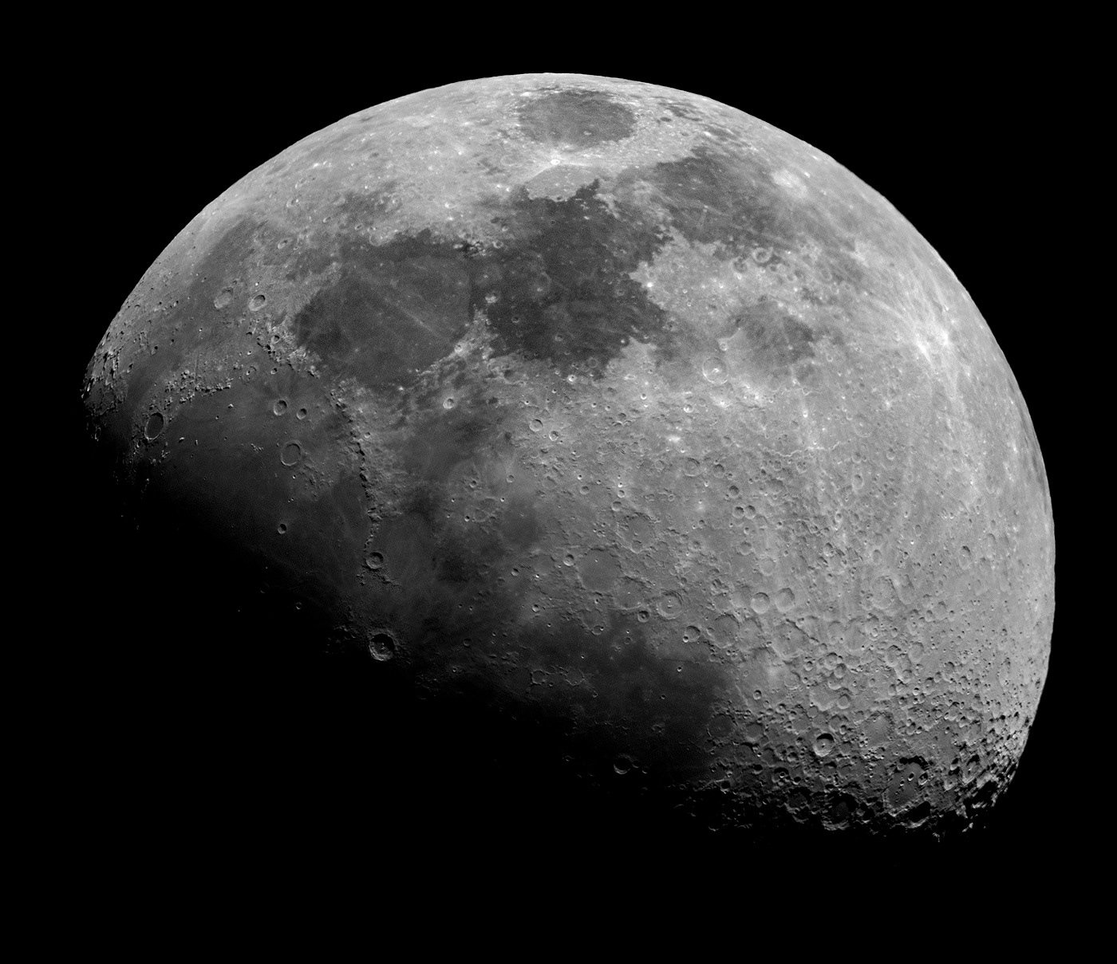
THE MOON: 1 light-second away

Slide 20
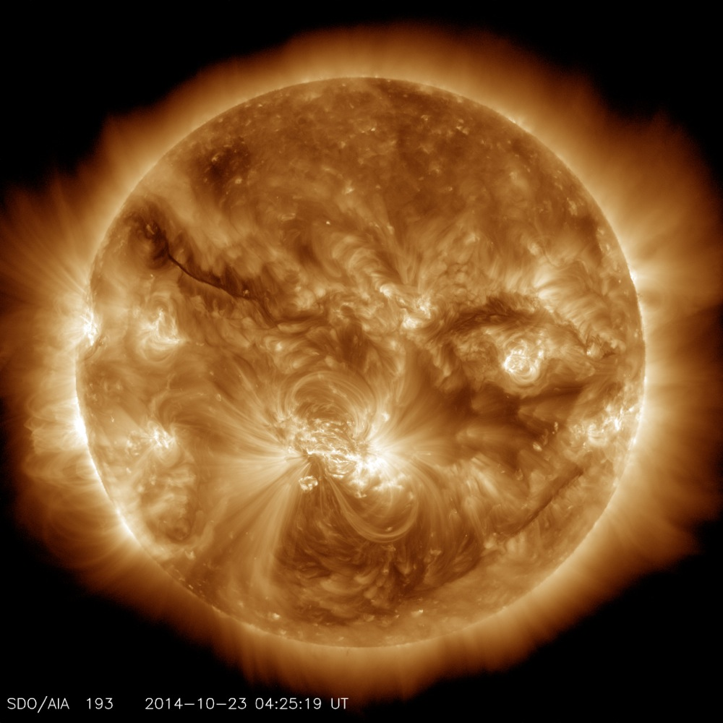
THE SUN: 500 light-seconds away (8 light-minutes)
Notes:
Aka 1 AU!

Slide 21
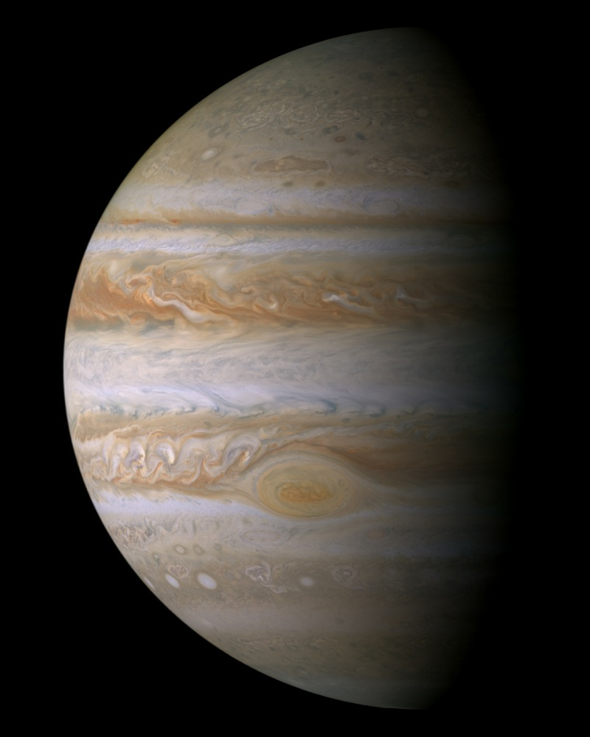
JUPITER: 40 light-minutes away
Notes:
In other units, Jupiter is 5.2 AU from the Sun (on average)

Slide 22
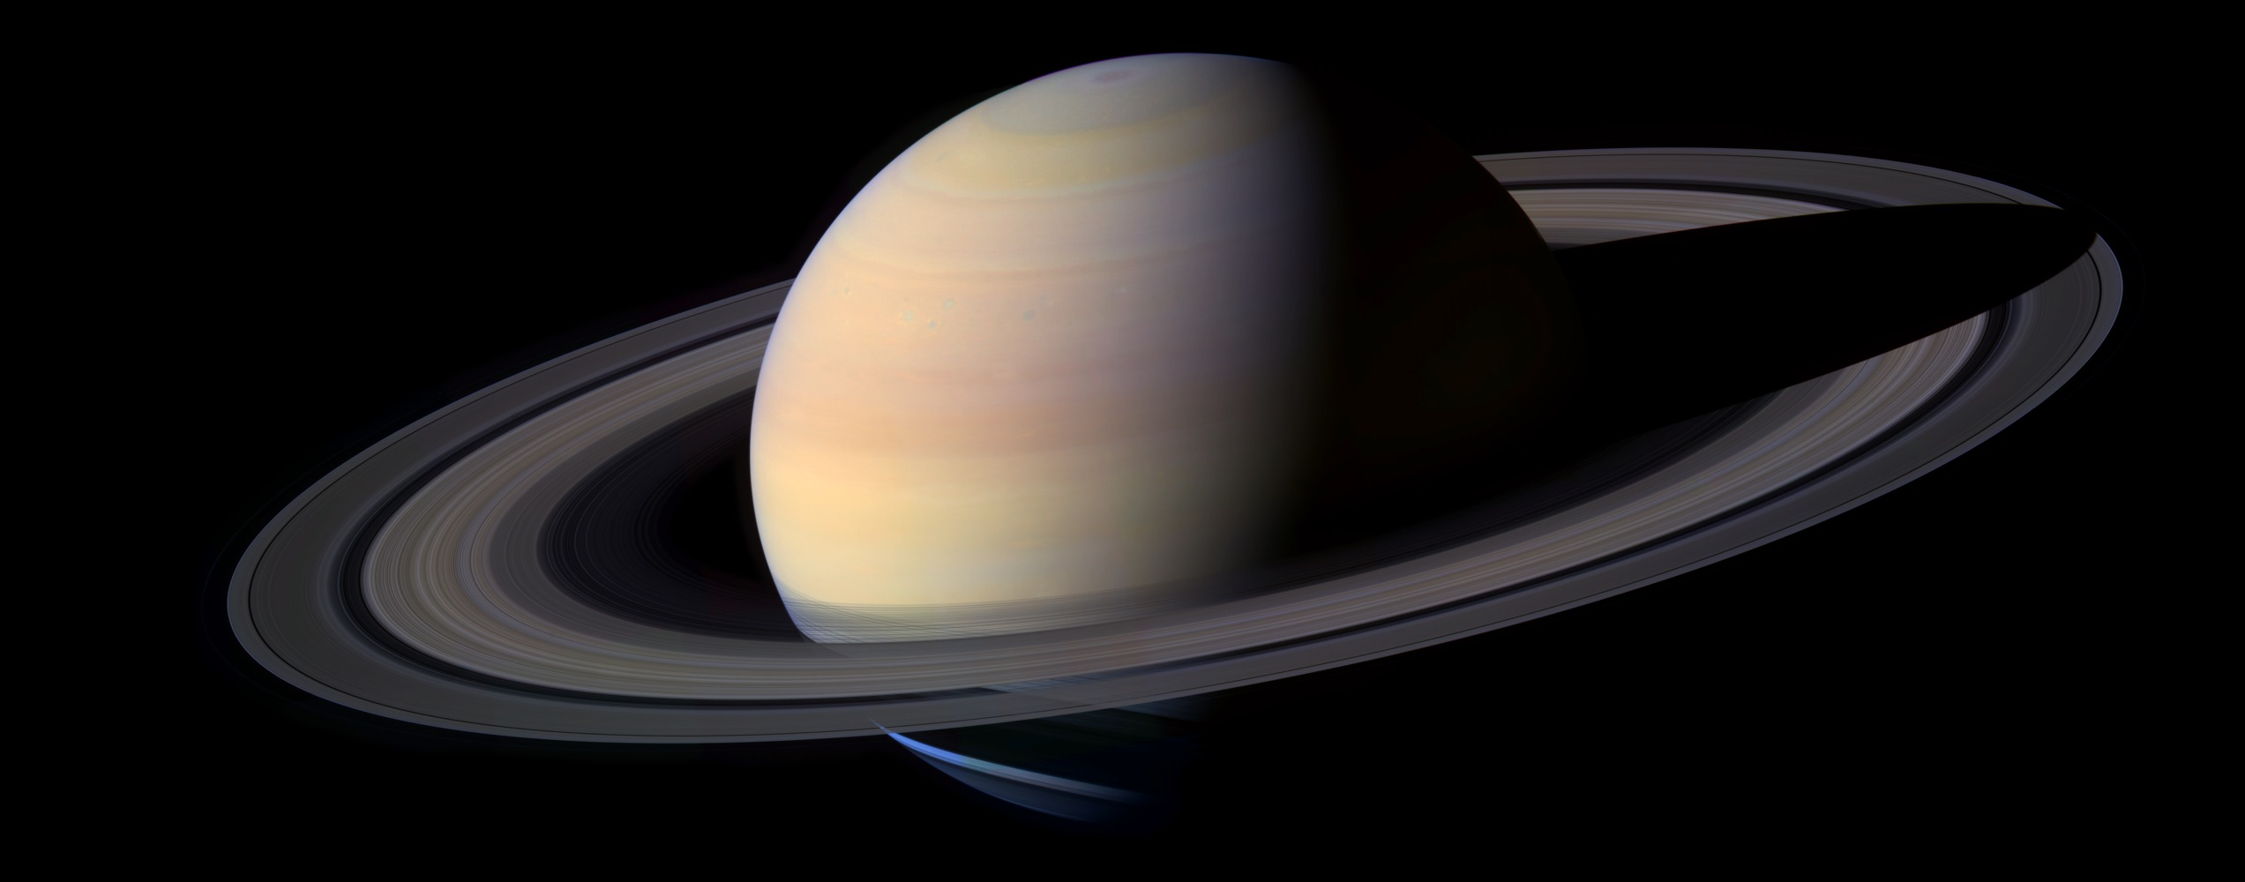
SATURN: 75 light-minutes away
Notes:
9.6 AU from the Sun (on average)

Slide 23
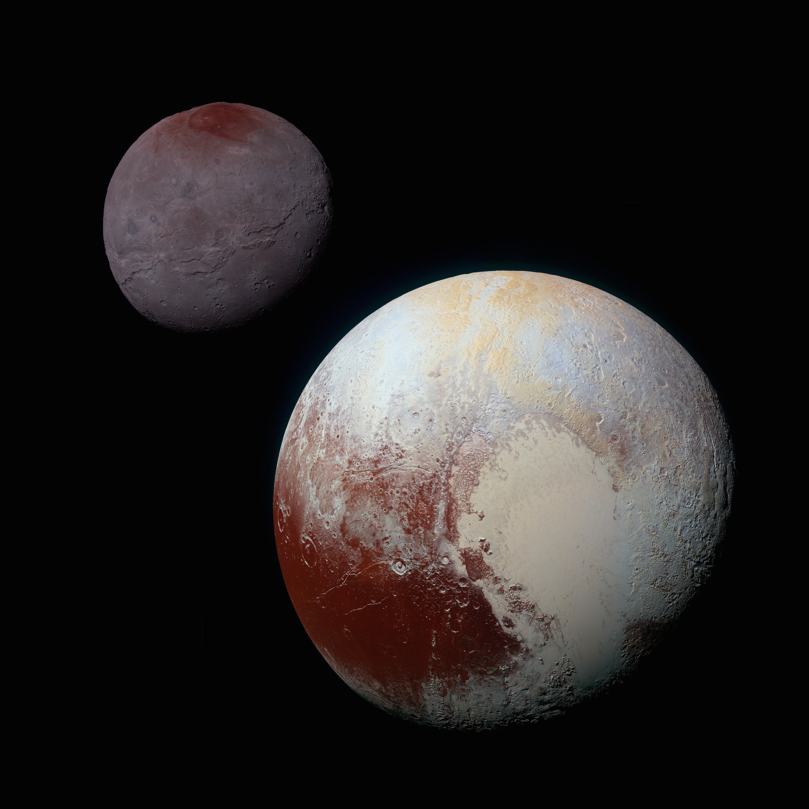
PLUTO: 5 light-hours away
Notes:
39.5 AU from the Sun (on average)

Slide 24
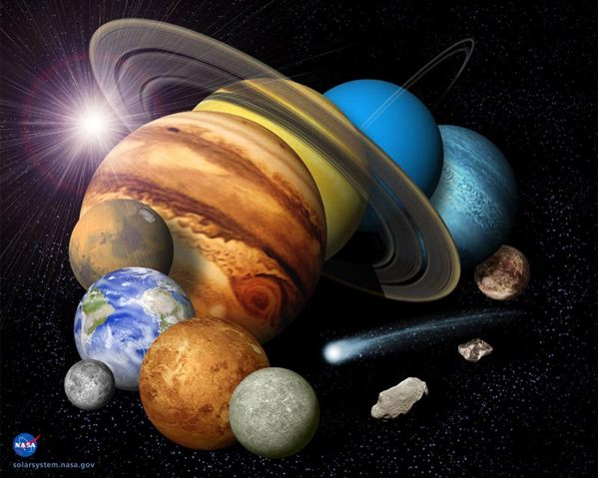
Scale of the Solar System
Let’s build a 1 : 10,000,000,000 solar system
Sun
grapefruit
Mercury
salt/sand grain
19 feet away
Venus
peppercorn
36 feet away
Earth
peppercorn
49 feet away
Mars
big salt / small pepper
75 feet away
Jupiter
marble
250 feet away
Pluto
head of pin
1/3 mile away

Slide 25
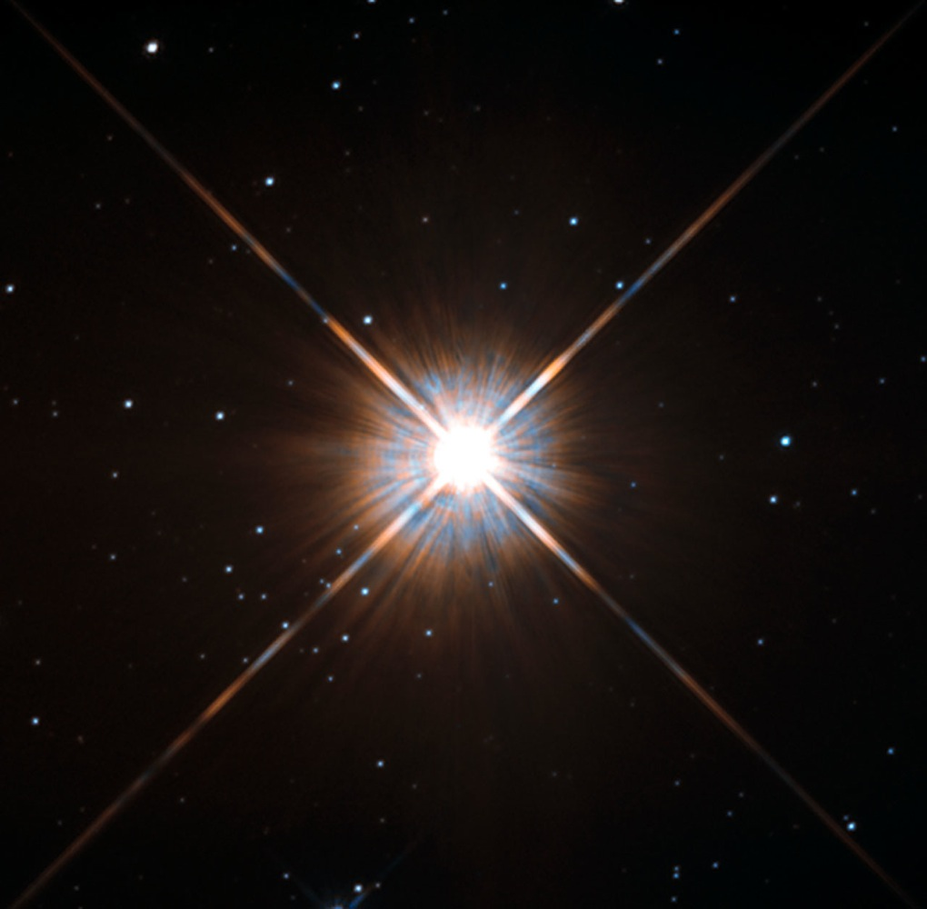
PROXIMA CENTAURI: 4 light-years away
Notes:
4 light years is 252,964 LY. For things this far away, it’s easier to use a unit like LY than AU

Slide 26
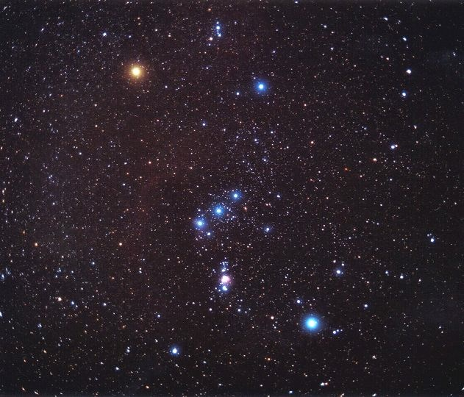
BETELGEUSE: 600 light-years away

Slide 27
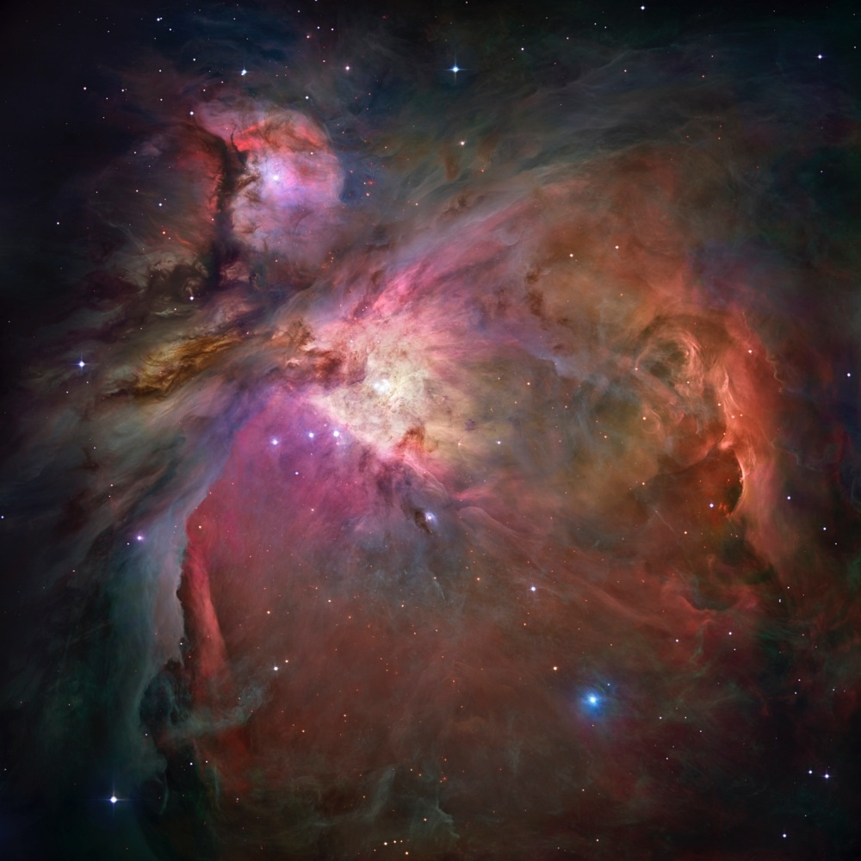
THE ORION NEBULA: 1300 light-years away

Slide 28
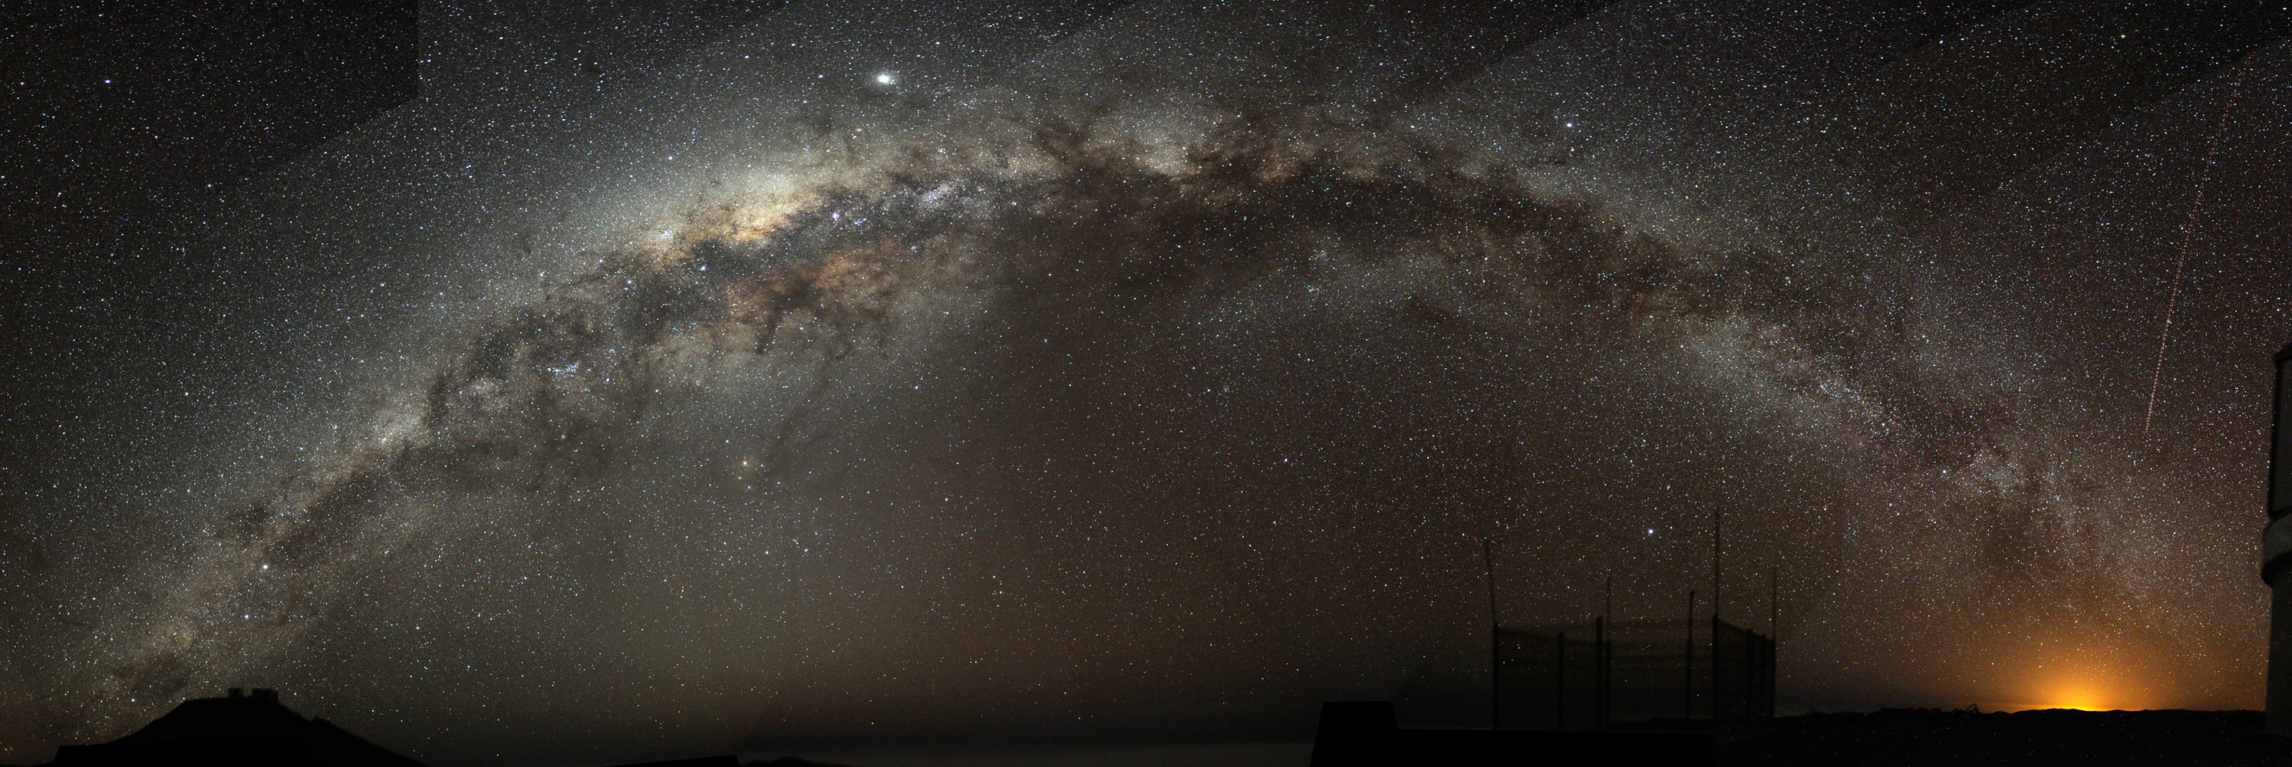
THE MILKY WAY’S CENTER: 25,000 light-years away

Slide 29
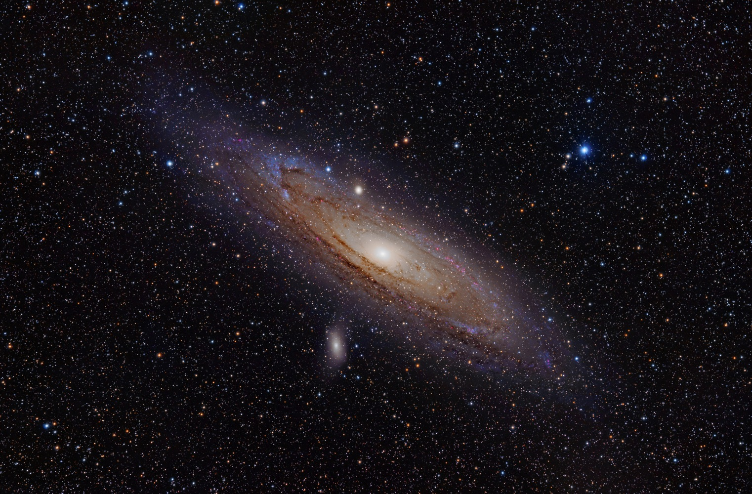
THE ANDROMEDA GALAXY: 2,500,000 light-years away

Slide 30
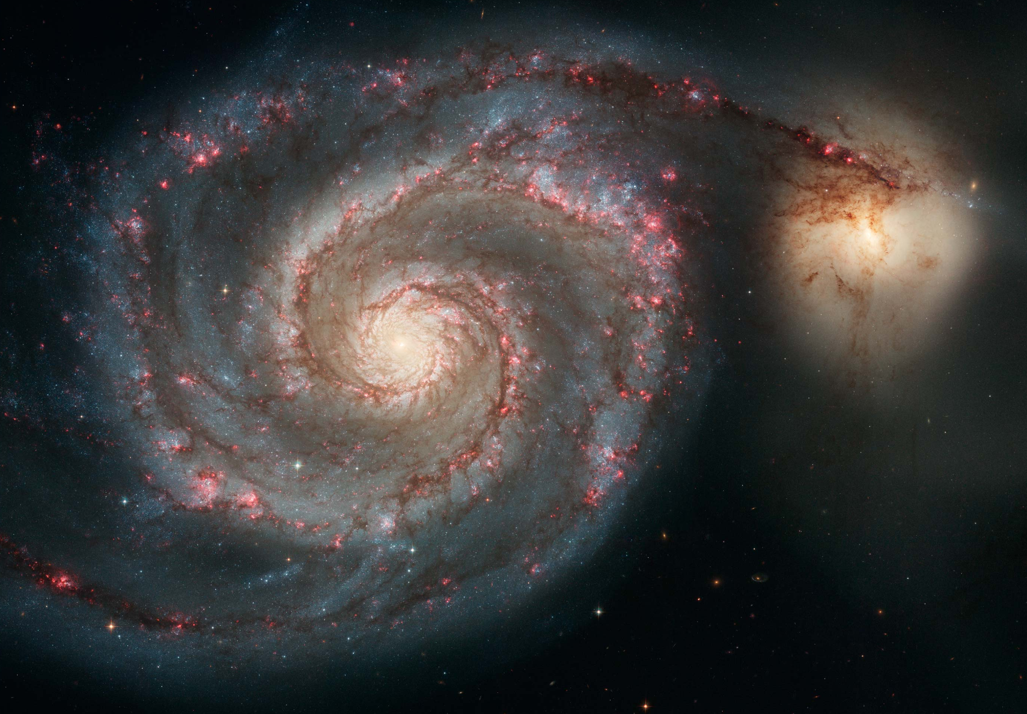
THE WHIRLPOOL GALAXY: 25,000,000 light-years away

Slide 31
THE FIRST GALAXIES: 10,000,000,000 light-years away

Slide 32
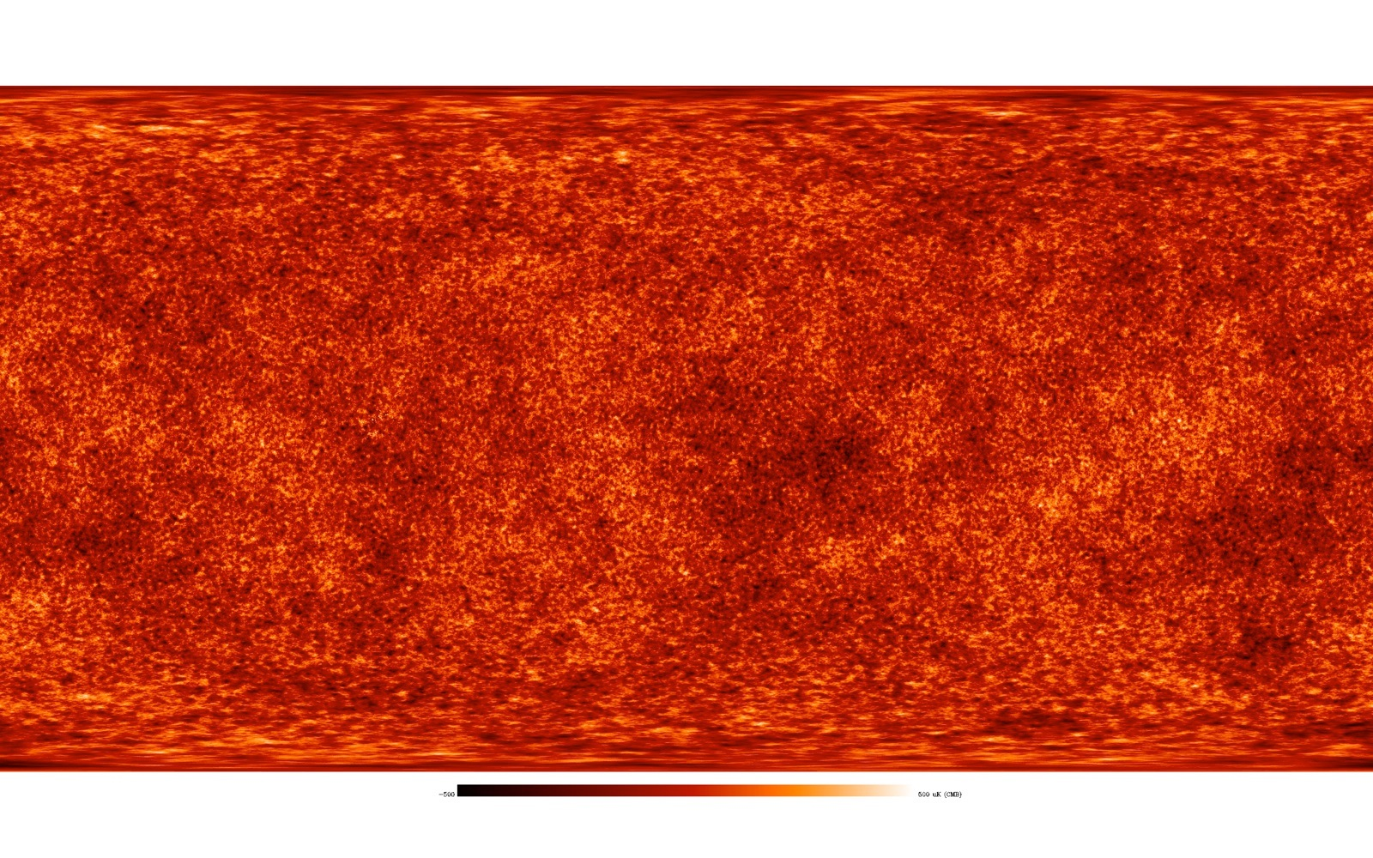
THE COSMIC MICROWAVE BACKGROUND: 13,800,000,000 light-years away

Slide 33
Far away means back in time
Light travels at a finite speed (300,000 km/s).
Thus, we see objects as they were in the past:
The farther away we look in distance, the further back we look in time.
Destination | Light travel time
Moon | 1 second
Sun | 8 minutes
Sirius | 8 years
Andromeda Galaxy | 2.5 million years

Slide 34
How do we know the Earth is round?
watching a ship over the horizon
looking at moon, seeing the shadow in eclipses
the diffraction of light at sunset
follow the path of a single star
two structures at different locations on Earth, measure their shadows
we have time zones (and can call our friends where it’s dark)
sail around the planet
we can orbit the Earth and look at it
stars different cross hemispheres
double sunsets! (you can take an elevator up a tall building to see a second sunset)
theoretical considerations! gravity pressing down symmetrically makes things round
angles of a triangle not matching 180
Notes:
You might not draw the sphere conclusion from many of these observations, if living with a Flat Earth view.

Slide 35
History of the Universe

Slide 36
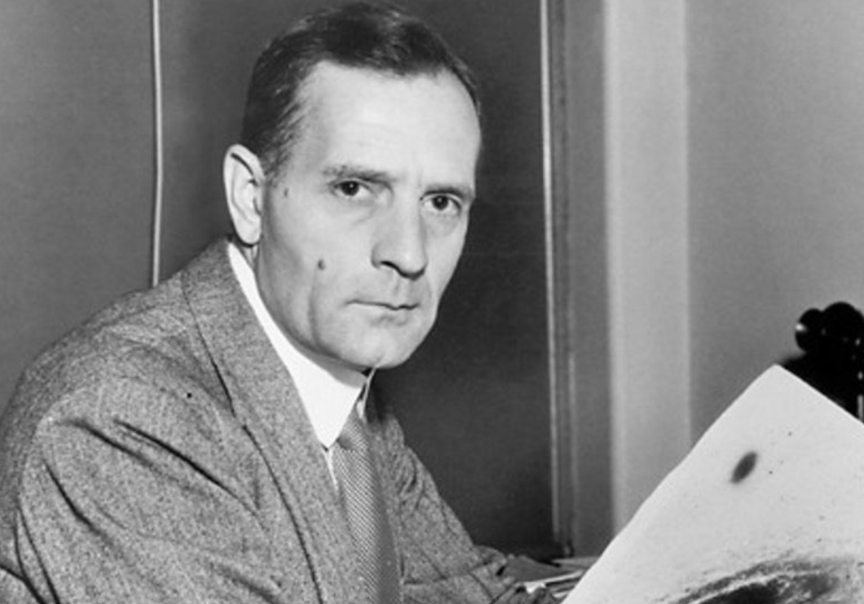
Our Cosmic Origins
Big Bang – beginning of the Universe: ~14 billion years ago
Galaxy groups/clusters are flying away from each other
Notes:
Bonus material: why do we believe the Big Bang happened? http://astronomy.swin.edu.au/cosmos/b/big+bang
This cheerful gent, going by the name Edwin Hubble, observed the farthest galaxies from us are moving faster than those closest
https://apod.nasa.gov/diamond_jubilee/1996/hub_1929.html

Slide 37
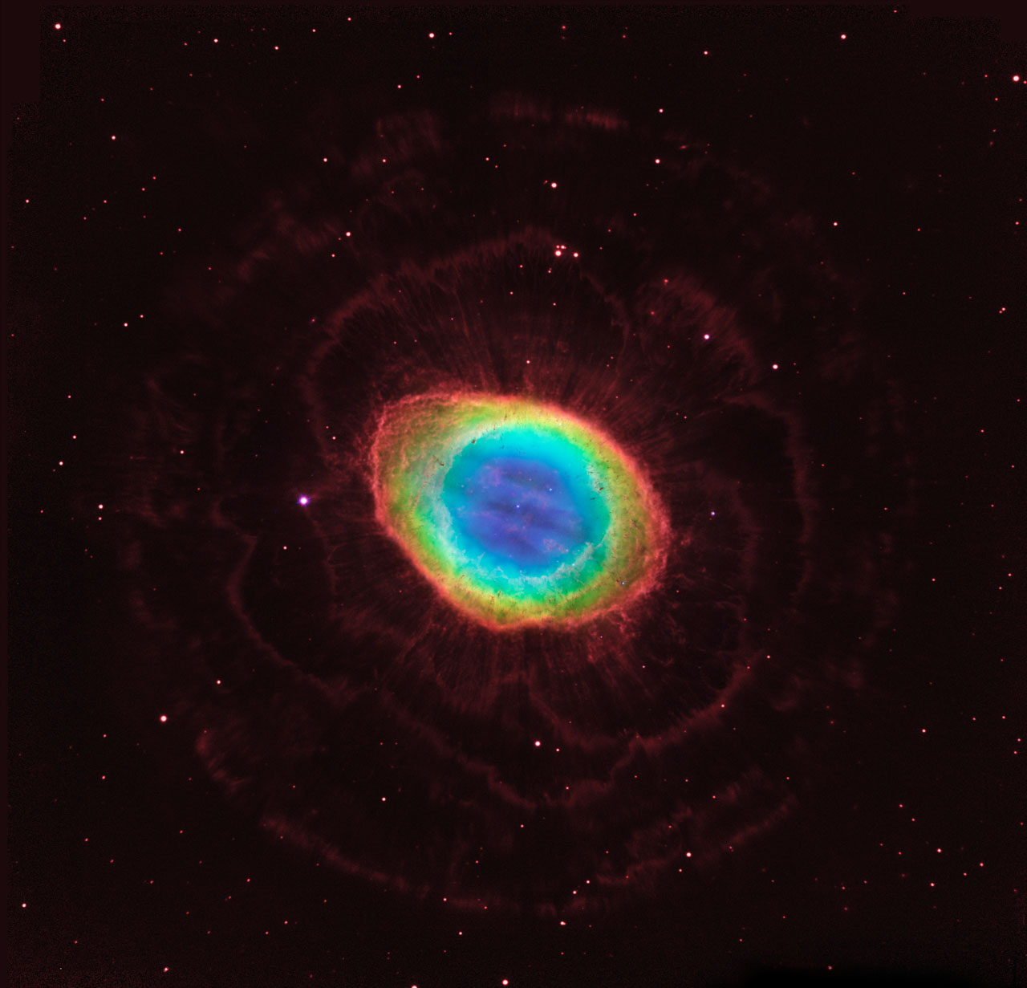
Our Cosmic Origins
Big Bang – beginning of the Universe: ~14 billion years ago
Galaxy groups/clusters are flying away from each other
No expansion within galaxies
Only hydrogen & helium in the early Universe
All other elements were created inside stars
We are all created from the star stuff
Current composition of the Sun: 70% H, 28% He, 2% others
Notes:
Remember this planetary nebula from the first lecture? All that material it sloughed off is rich with heavy elements that helps make us who we are!
https://www.nasa.gov/mission_pages/hubble/science/ring-nebula.html

Slide 38
The Cosmic Calendar
The entire age of the Universe – 1 year
The Milky Way formation − February
The Solar System formation – August 13
Large creatures appeared on Earth – December 13
Dinosaurs vanished – December 30
Early humans – December 31, 9:00 p.m.
Egyptian pyramids built – 13 seconds ago

Slide 39
Most of what we know is SO recent!
It was just a hot cosmic second ago that Kepler and Galileo demonstrated a heliocentric picture: we orbit the Sun, not the other way around

Slide 40
The Cosmic Calendar
The entire age of the Universe – 1 year
The Milky Way formation − February
The Solar System formation – August 13
Large creatures appeared on Earth – December 13
Dinosaurs vanished – December 30
Early humans – December 31, 9:00 p.m.
Egyptian pyramids built – 13 seconds ago
Your birth – 0.1 second ago

Slide 41
Spaceship Earth
Our motions in space and time
*not the one at Epcot..
Notes:
Section 1.3

Slide 42
Cosmic Motions
As we sit/stand here…
Earth is rotating
Notes:
https://www.youtube.com/watch?v=PIedt8uOxCE

Slide 43
Cosmic Motions
As we sit/stand here…
Earth is rotating
We’re orbiting the Sun
Notes:
https://www.youtube.com/watch?v=_QcgDiF1a14

Slide 44
Cosmic Motions
As we sit/stand here…
Earth is rotating
We’re orbiting the Sun
The Sun is orbiting the Milky Way

Slide 45
Galactic rotation, dark matter
How do we know galaxies rotate?
Observe how smaller parts of them move!
Compare those observations to physics
What’s weird about galactic rotation is one of Astronomy’s biggest, neatest mysteries
Who predicted it? Fritz Zwicke
Who observed it? Vera Rubin and W. Kent Ford, Jr.
Notes:
Hidden figure alert! Vera Rubin passed away in late 2016, passed over year after year for the Nobel prize in Physics. I was lucky enough to know her, she was a lovely, kind, and brilliant person. https://en.wikipedia.org/wiki/Vera_Rubin
http://adsabs.harvard.edu/abs/1970ApJ...159..379R → the actual paper published in 1970
https://astrobites.org/2016/12/27/how-one-person-discovered-the-majority-of-the-universe-the-work-of-vera-rubin/

Slide 46
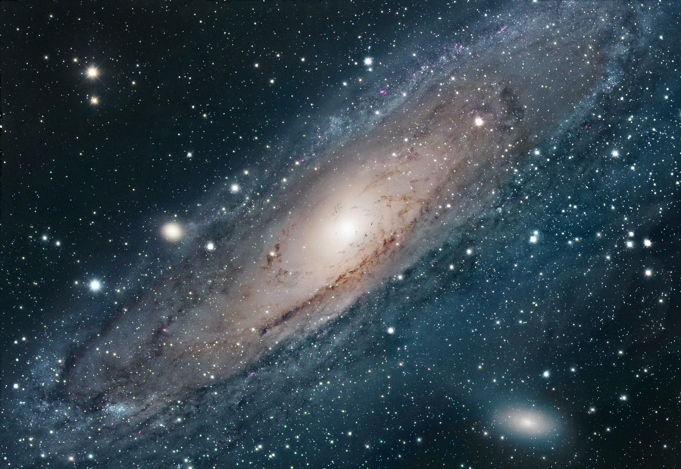
Cosmic Motions
As we sit/stand here…
Earth is rotating
We’re orbiting the Sun
The Sun is orbiting the Milky Way
The Milky Way is moving in the Local Group
Galaxies in the local group aren’t moving away from us
Our nearest (large) galactic neighbor, Andromeda →
Notes:
The Magellanic Clouds are technically dwarf galaxies, and closer to us than Andromeda

Slide 47
Cosmic Motions
As we sit/stand here…
Earth is rotating
We’re orbiting the Sun
The Sun is orbiting the Milky Way
The Milky Way is moving in the Local Group
The Local Group is part of a Supercluster of galaxies
Notes:
I’m not showing a picture of the Milky Way, or the cluster of galaxies it’s in.. Why not?
https://scitechdaily.com/hubble-views-galaxy-cluster-abell-1413/

Slide 48
Cosmic Motions
As we sit/stand here…
Earth is rotating
We’re orbiting the Sun
The Sun is orbiting the Milky Way
The Milky Way is moving in the Local Group
The Local Group is part of a Supercluster of galaxies
Superclusters of galaxies are entrained in an expanding Universe
Notes:
https://www.e-education.psu.edu/astro801/content/l10_p6.html

Slide 49
The human adventure of astronomy

Slide 50
Practical, social, technological shifts
Practical applications:
navigation
calendar systems
A driver of revolutions in:
social change and thought
our perception of the planet (round!)
Notes:
Copernicus proposed a heliocentric view in 1543. Galileo, Brahe, and Kepler made the observations that proved it; Galileo was put under house arrest by the church for heresy in 1633. Galileo was forgiven officially py Pope John Paul II in 1992!

Slide 51
Practical, social, technological shifts
Practical applications:
navigation
calendar systems
A driver of revolutions in:
social change and thought
our perception of the planet (round!)
Notes:
Copernicus proposed a heliocentric view in 1543. Galileo, Brahe, and Kepler made the observations that proved it; Galileo was put under house arrest by the church for heresy in 1633. Galileo was forgiven officially py Pope John Paul II in 1992!

Slide 52
Practical, social, technological shifts
Practical applications:
navigation
calendar systems
A driver of revolutions in:
social change and thought
our perception of the planet (round!)
Notes:
Copernicus proposed a heliocentric view in 1543. Galileo, Brahe, and Kepler made the observations that proved it; Galileo was put under house arrest by the church for heresy in 1633. Galileo was forgiven officially py Pope John Paul II in 1992!

Slide 53
Practical, social, technological shifts
Practical applications:
navigation
calendar systems
A driver of revolutions in:
social change and thought
our perception of the planet (round!)
in the Universe (it doesn’t revolve around the Earth)
Notes:
Copernicus proposed a heliocentric view in 1543. Galileo, Brahe, and Kepler made the observations that proved it; Galileo was put under house arrest by the church for heresy in 1633. Galileo was forgiven officially py Pope John Paul II in 1992!

Slide 54
Practical, social, technological shifts
Practical applications:
navigation
calendar systems
A driver of revolutions in:
social change and thought
our perception of the planet (round!)
in the Universe (it doesn’t revolve around the Earth)
Huge advances in technology
Newton’s laws laid foundation for the industrial revolution
space travel
computation
Notes:
Copernicus proposed a heliocentric view in 1543. Galileo, Brahe, and Kepler made the observations that proved it; Galileo was put under house arrest by the church for heresy in 1633. Galileo was forgiven officially py Pope John Paul II in 1992!

Slide 55
Recap!
The scale of the Universe: almost inconceivably vast. Expand out and continually have to convert distance scales: m, au, light years, parsecs, redshift
History of the Universe: a lot happened before we got here! Big bang, expansion, a generation of star formation, we were born of star stuff (metal enrichment by end of stars’ lives)
Spaceship Earth: we rotate and orbit a body (the Sun) that is rotating and orbiting a body (the Milky Way) that is rotating and orbiting a cluster (the Local Group) that is along for the ride with a body (a galaxy Supercluster) that is part of a filament in the expanding universe
The human adventure of astronomy: has shaped how we think about the Earth, its place in the Universe, and exploration. Driver of social change, technological advancement

Slide 56
Pale Blue Dot (Potentially disturbing images, viewer discretion is advised) https://www.youtube.com/watch?v=sb4WhNvLRFw&frags=pl%2Cwn
Notes:
Video has some footage/images of war.

